Slide 1
The Cost of Doing Business
A Supermarket Services Story
Analysis Preformed by
Alec Schneider
&
Ross Conway

Slide 2
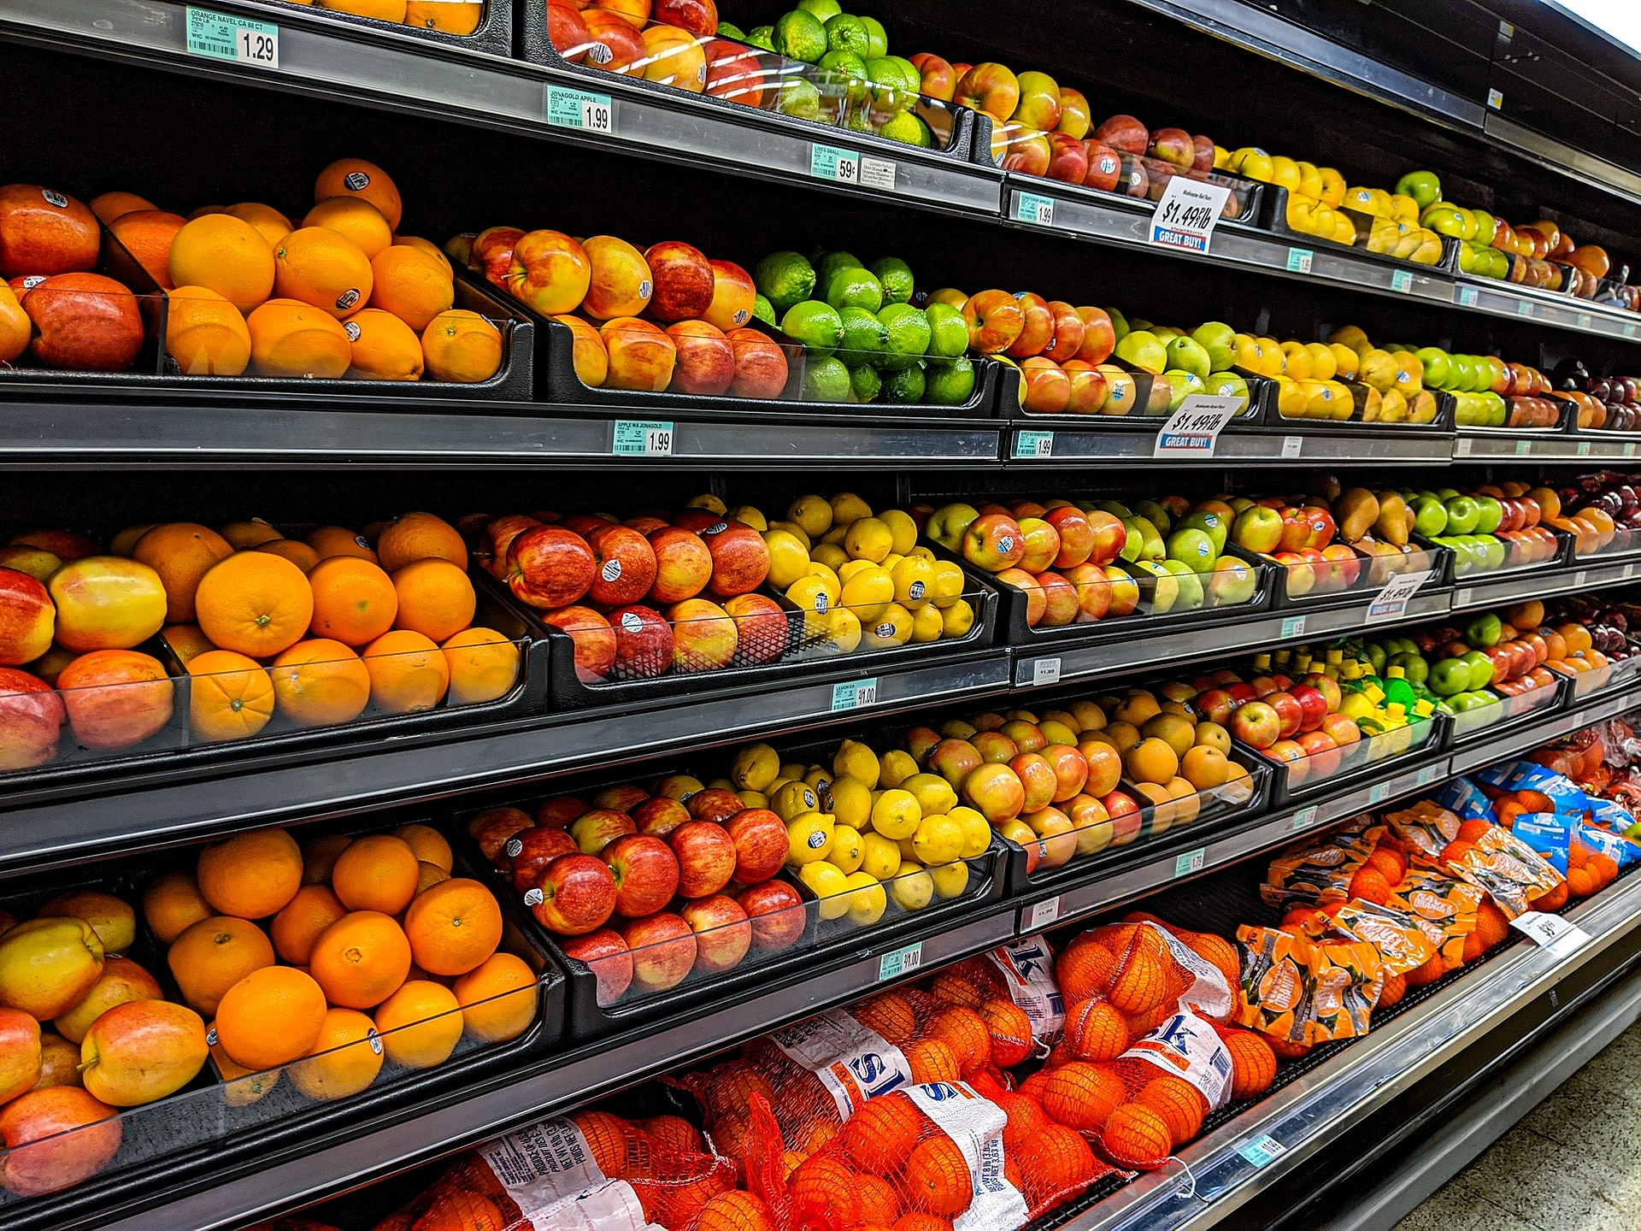
Its More Than Just the Food
Your average full size supermarket spends 65,000 annually on operational cost not related to goods, insurance, rent or payroll. This is a story about modeling and managing those costs.

Slide 3
What happened?
In 2011 Cushman & Wakefield Services is awarded all maintenance contracts for the Ahold Corporation.
It would take a full year to transition all service lines but by January 2012 all of the Ahold Corporation’s maintenance services were managed through Cushman & Wakefield Services.
This would mark the first time that all of the work order data for all maintenance costs would reside in a single system of record providing never before realized opportunities for data modeling and exploration.

Slide 4
Our Data Source and its Subsequent Cleaning
Our data comes from a now sun-set “WOM” or work order management system known as Corrigo. This system was built with few controls restricting users inputs for a variety of fields leading to a data set that at best can be called challenging.
Gaps in the data pertaining to geographic and service related fields were manually munged using a combination of general operational knowledge of the program or by being merged with the nearest geographical location.
Gaps in the cost data such as the allocation to labor vs materials were substituted using flat percentages based off of the specialty and the total cost of the work performed.

Slide 5
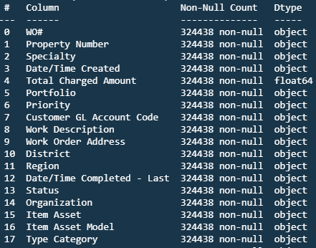
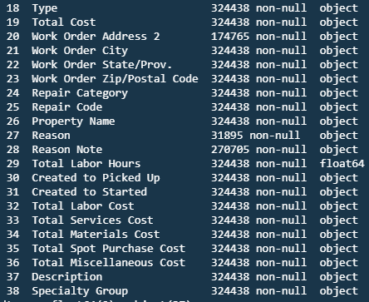
Our Data A Deeper Look
Key Terminology
Specialty: What trade does the service fall under? EG: Landscaping, Plumbing, HVAC…
Portfolio: What brand does the supermarket operate under? EG: Stop & Shop or Giant Food
Region: Smaller Geographic regions devide by the municipalities tax codes. Provides a more granular break down than the portfolio level.
Total Cost: Is the total cost to complete the service.
Total Charged Amount: Is the amount Billed to the Ahold Corporation (typically this is a flat 9% but can vary based on regional and municipal tax codes)

Slide 6
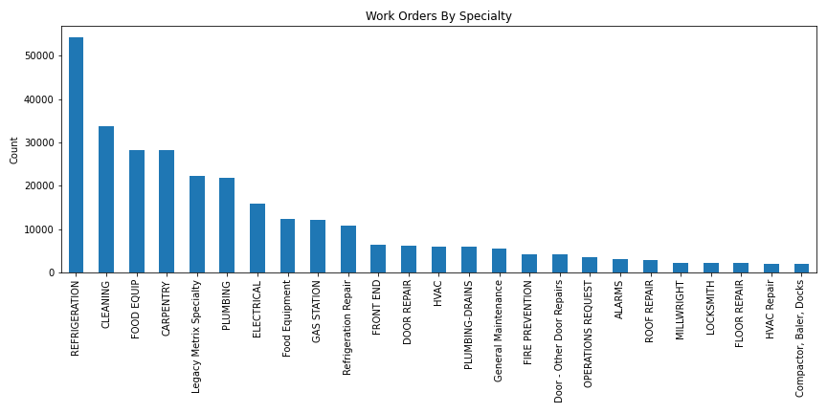
Data Exploration
Place holder What did we hope to understand better
Place holder What initial exploration was perfomed
Place holder What was gleamed from our initial exploration and how did it inform the models that we built
The Cost data for refrigeration work orders was being housed in JD Edwards not through the Corrigo system and would have to be populated and reran
Defunct Specialty codes were found when doing histograms of the volumetric data

Slide 7
Preparing our Models
How did we set them up?
Forecasted monthly costs for multiple segmentations, creating Prophet and Vector Auto Regression (VAR) time series models
Work order counts and total labor hours were used as input features with total cost (the target variable)
What did we encounter and try and work around while modeling the data?
With data being limited and dirty before 2012, some segments could not be modeled and would better be forecasted using historical rates
How did we do this?
Data was split by the different segmentations and passed to user defined functions to use the models to train, forecast, save, score, and plot

Slide 8
Results and Interpretation
Overall, multi-variable Prophet additive models and VAR models struggled to model the underlying trends in the data.
This is mainly due to the limitations in data management and processing of the Corrigo WOM system
Root Mean Squared Error and its % of the average monthly cost was very high after multiple rounds of tuning and additional training iterations

Slide 9
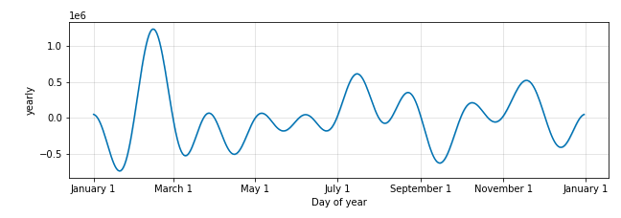
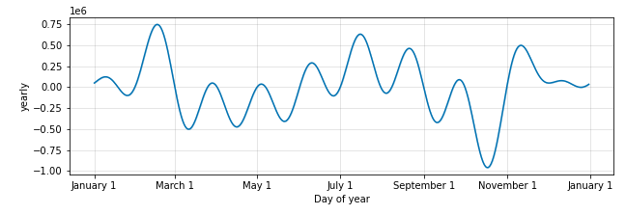
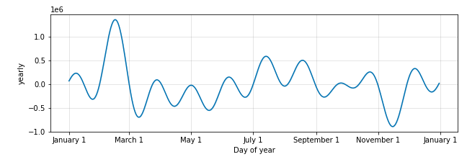
Prophet Seasonality
Stop & Shop
North
Strong Seasonality was Detected in the data set which at first seemed counter intuitive. Why would we be seeing seasonal variance in work order volume and cost?
Highlighted in red are spikes that seem to occur at uniform places across brands and regions with a major spike in February and again in July.
Highlighted in Yellow We can see that following the July spending there always is as dramatic reduction in spending until just before the end of the year holidays.
Central
South

Slide 10
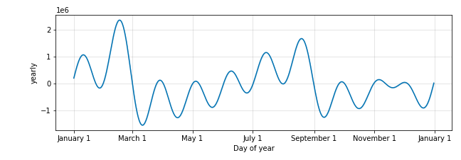
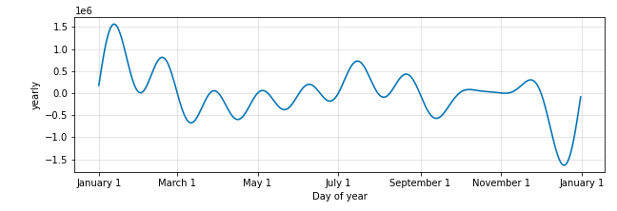
Prophet Seasonality Continued
The Giant Company
These trends held true for the Giant brands
The spikes occur before the major holidays. As discussed in class with the candy sales we are seeing that store managers are putting in an increased volume of tickets to prepare for the influx of holiday shoppers
The higher average prices during the summer months shown in the stop and shop brand are most readily accounted for by the influx in HVAC and Refrigeration work orders from the increased loads placed on the systems by the higher temperatures. This effect is less marked in the giant brands As they are located more southernly geographically speaking.
Giant Food
Giant Martins

Slide 11
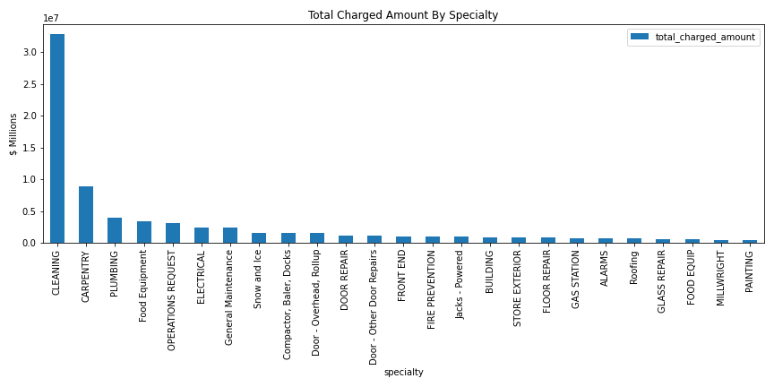
Digging into Work Order Specialty
Our initial data exploration provided us with some insight as to where to most effectively direct our attentions.
When looking at costs Floor Cleaning, Carpentry, Plumbing and Food Equipment repairs are the main cost drivers with Floor Cleaning leading by a large margin.
In terms of volume Refrigeration, Floor Cleaning, Food Equipment, Carpentry and Plumbing act as the main drivers.

Slide 12
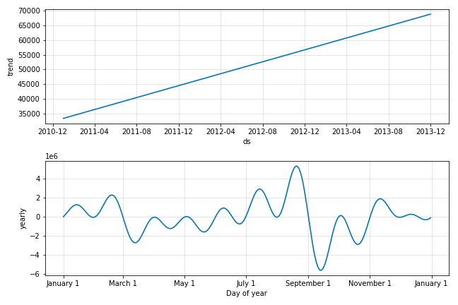
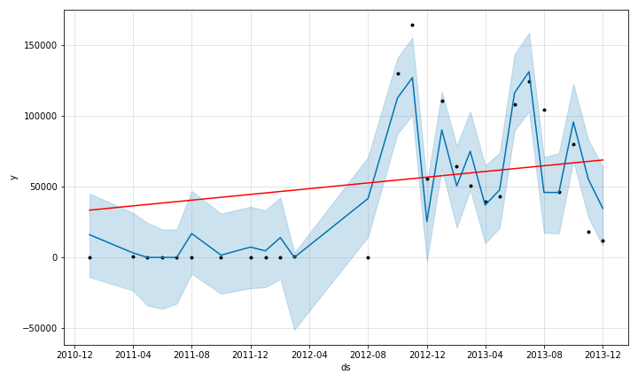
Cleaning
The daily cleanings and weekly waxing of a location with an interior area of nearly a football pitch makes this the largest cost driver and second largest volume driver
Place holder anecdote to explain the trend were seeing

Slide 13
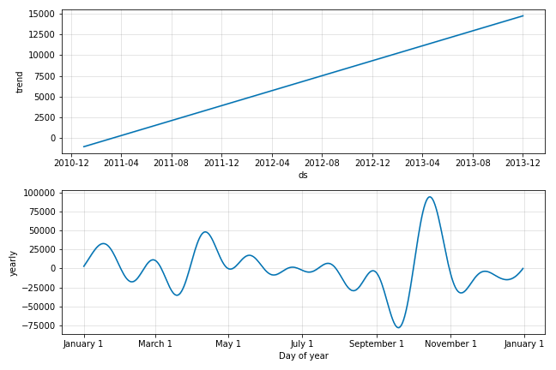
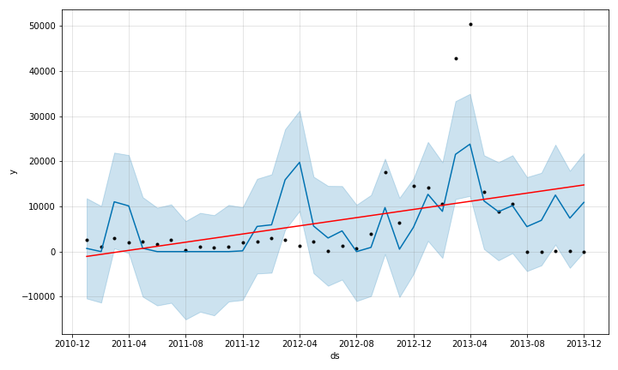
Plumbing
Place Holder Brief description of the specialty
Place holder anecdote to explain the trend were seeing

Slide 14
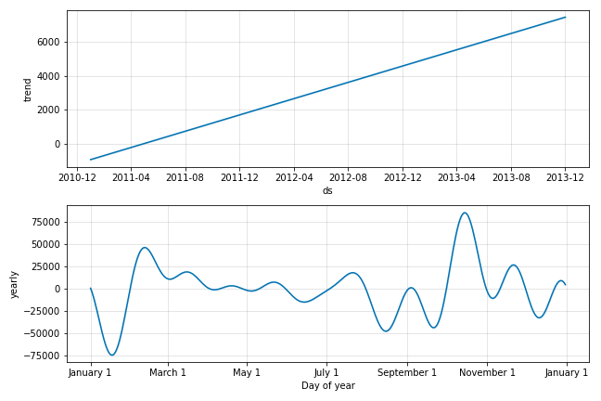
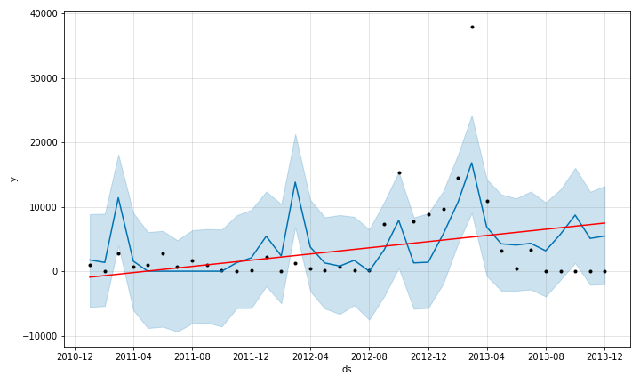
Food Equipment
Place Holder Brief description of the specialty
Place holder anecdote to explain the trend were seeing

Slide 15
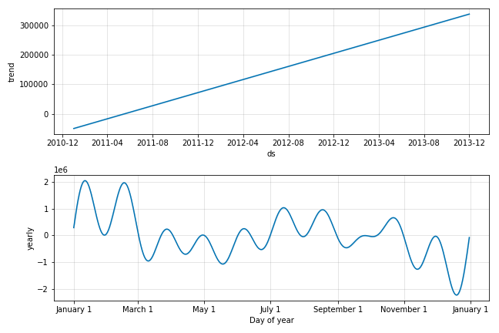
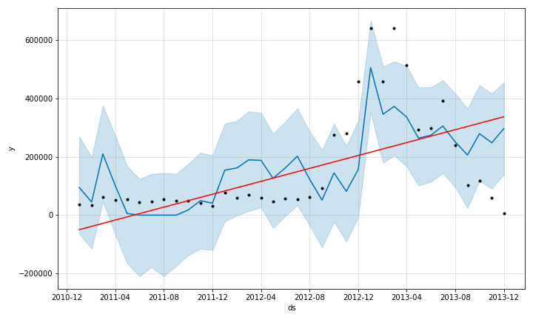
Carpentry
Place Holder Brief description of the specialty
Place holder anecdote to explain the trend were seeing

Slide 16
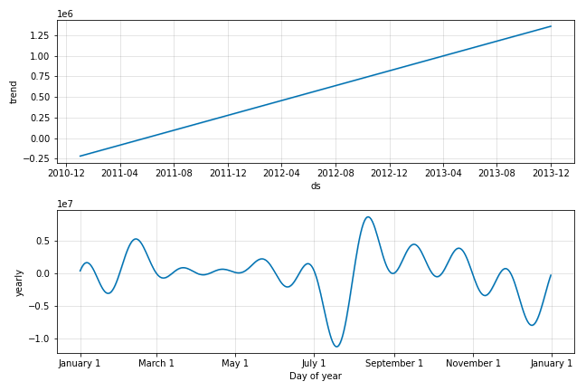
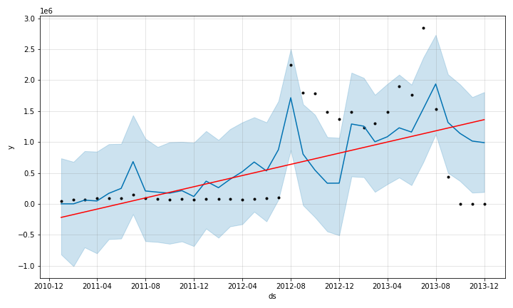
Refrigeration
Place Holder Brief description of the specialty
Place holder anecdote to explain the trend were seeing

Slide 17
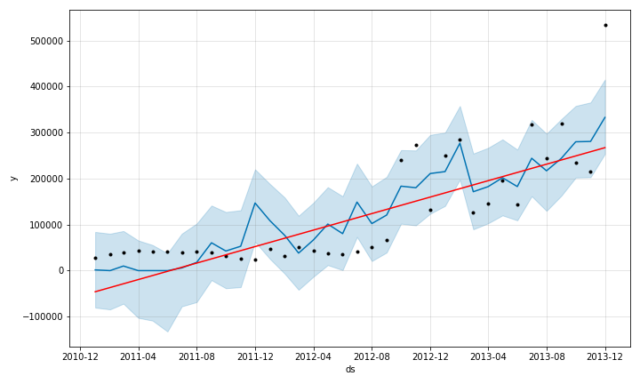
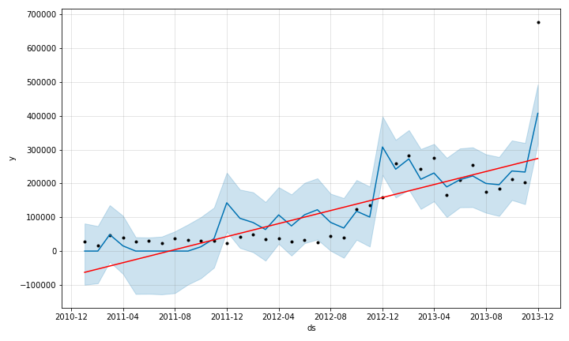
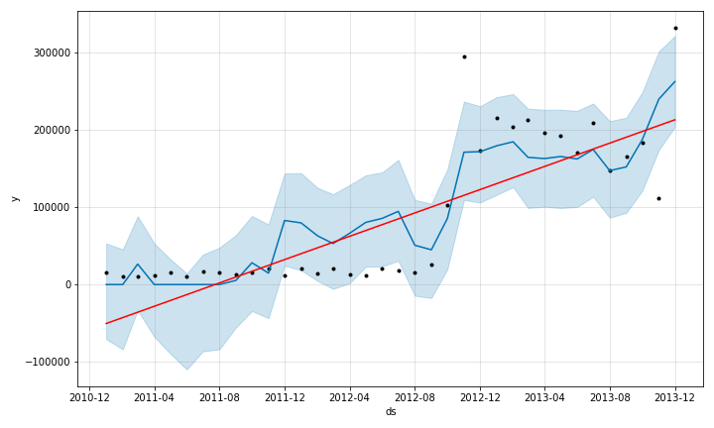
Stop & Shop
Forecast Plot with Change Points
Place Holder Summary Statement
North
Central
South

Slide 18
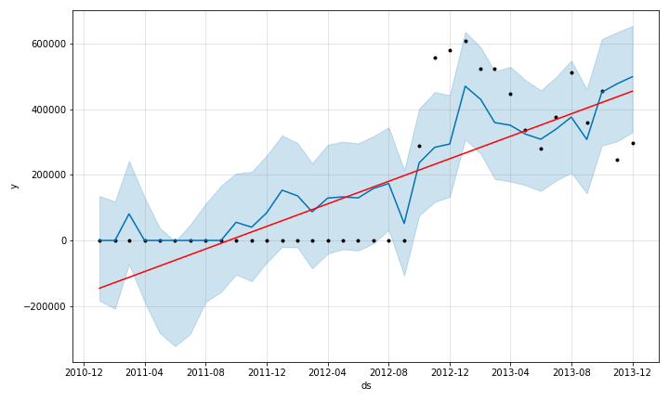
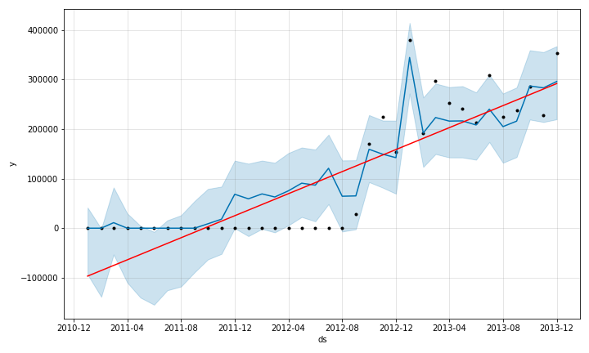
The Giant Company
Forecast Plot with Change Points
Place Holder Summary Statement
Giant Food
Giant Martins

Slide 19
Conclusion
Summary
Better data entry, management, and engineering is needed to collect work order data. Should be technology’s main priority in order to allow modelers to reasonably forecast important costs and work orders

Slide 20
Appendix

Slide 21
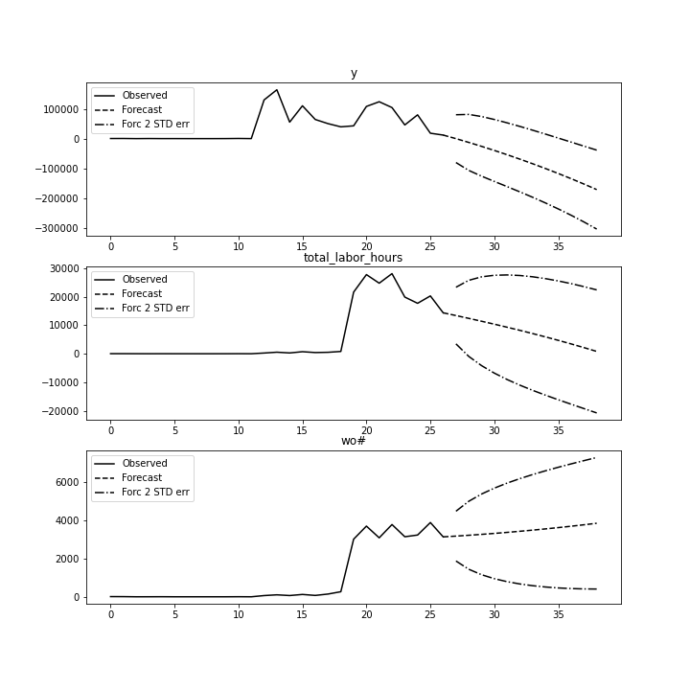
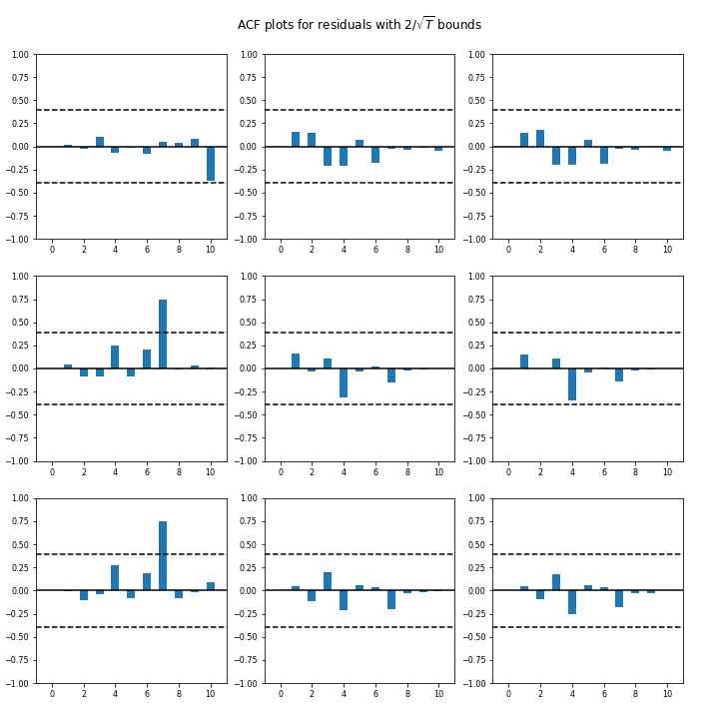
Cleaning – VAR
VAR struggles and begins to forecast negative costs

Slide 22
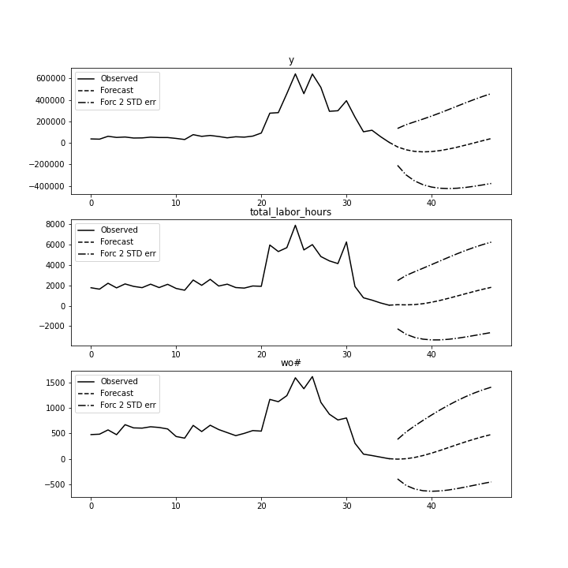
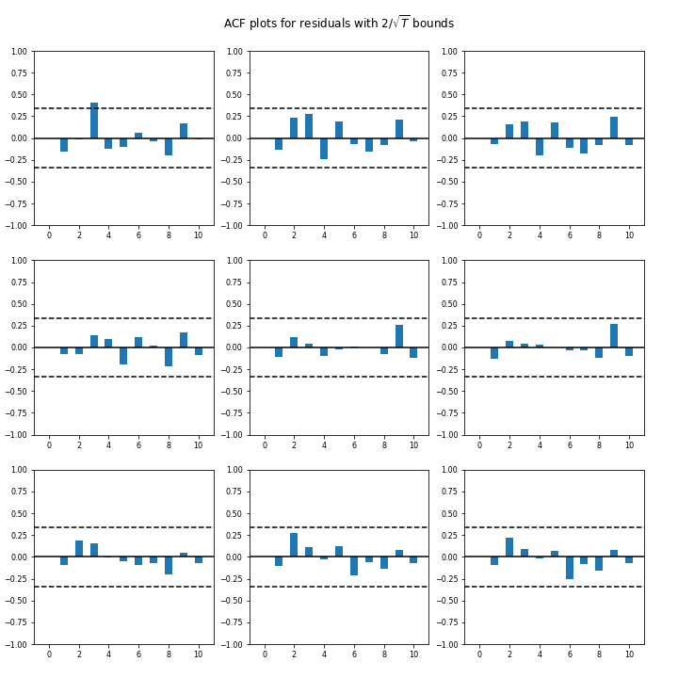
Carpentry - VAR
Again we see a struggle in trend finding

Slide 23
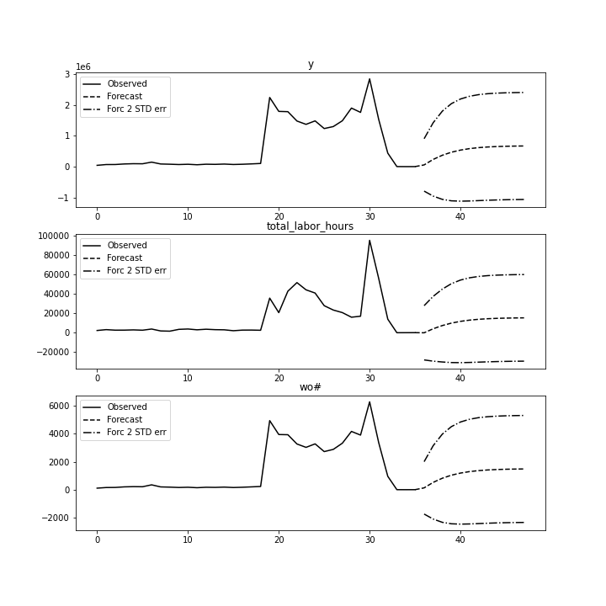
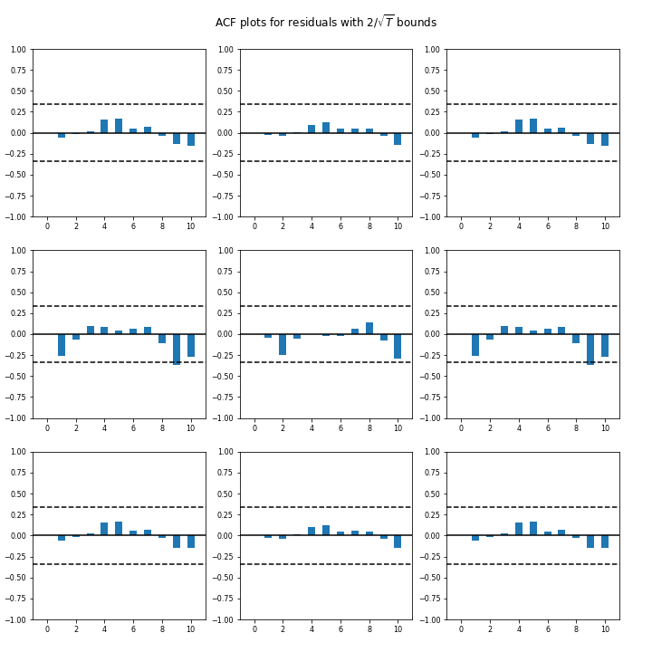
Refrigeration - VAR
Very wide 2 STD error with a struggle to adapt to recent trend

